Slide 1





Tooth Profile Training

Slide 2

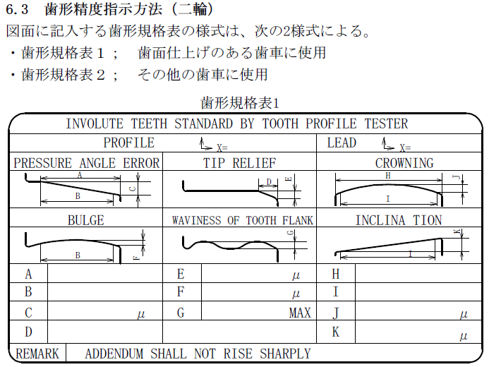
Tooth Profile Training
2W
SHAVING & GRINDING PROCESS
FOR FINISH CUT GEAR FACE ITEMS

Slide 3
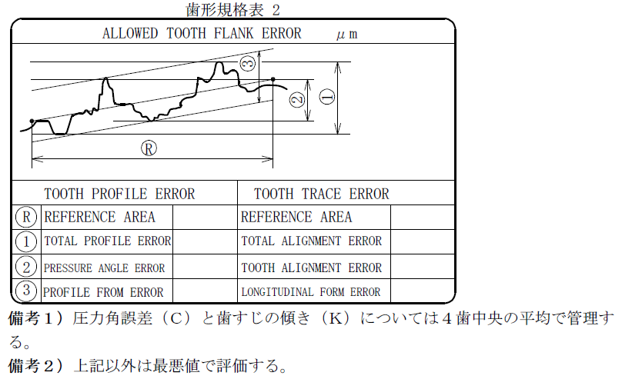
Tooth Profile Training
2W
HOBBING FINISH
HOBBING CUT ITEMS

Slide 4
Tooth Profile Training
2W
SHAVING GRINDING PROCESS
FOR FINISH CUT GEAR FACE ITEMS

Slide 5

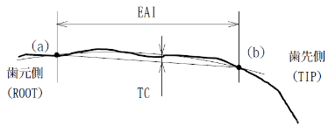
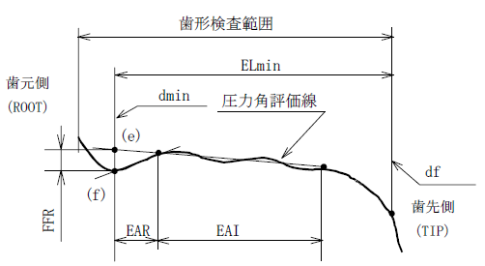
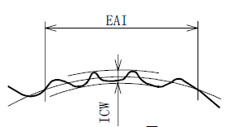
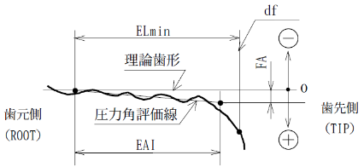
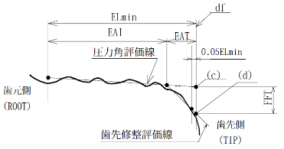
Tooth Profile Training
➢Involute Teeth Profile

Slide 6
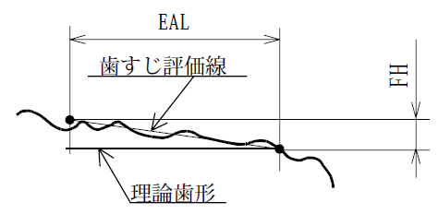
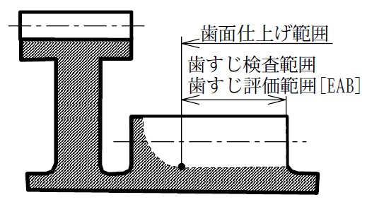
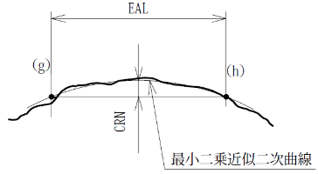
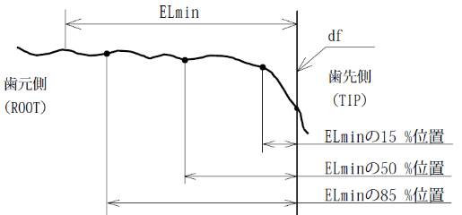
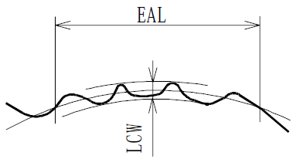
Tooth Profile Training
➢Lead Teeth Profile
Lead Evaluation Line
Tooth Surface Finishing Range
Lead Inspection Range
Lead Evaluation Range [EAB]
Theoretical Teeth Profile

Slide 7





Tooth Profile Training
Tooth Profile Measure
1st Tooth
EX) 4tooth 3position
Ｔｏｐ （ ENG Side）
Tip
2nd tooth
2nd tooth
Ｂｏｔｔｏｍ
Root
2nd tooth
Involute
Ｔｏｐ （ ENG Side）
Ｔｏｐ （ ENG Side）
Tip
Tip
Lead
Ｂｏｔｔｏｍ
Root
Ｂｏｔｔｏｍ
Root

Slide 8
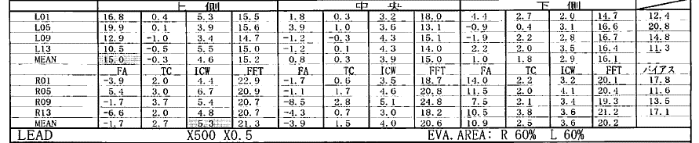







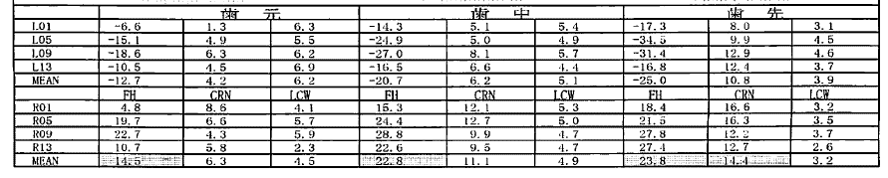







Tooth Profile Training
Tooth profile Locations which need to be evaluated
◎ Involute
FA central MEAN value shall be within the spec, and apart from it all other parameters should be with in the GEAR`s individual specs
◎ Lead
FH central MEAN value shall be within the spec, and apart from it all other parameters should be with in the GEAR`s individual specs

Slide 9
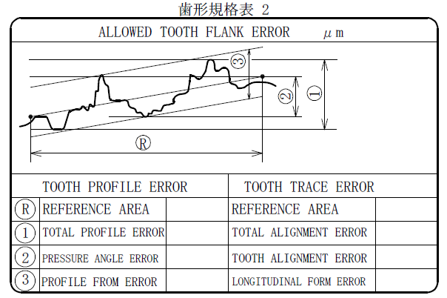
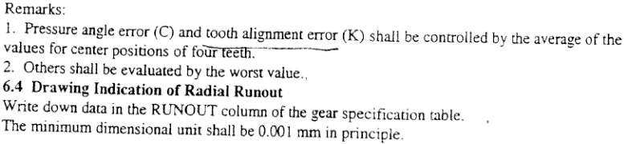
Tooth Profile Training
2W
HOBBING FINISH

Slide 10
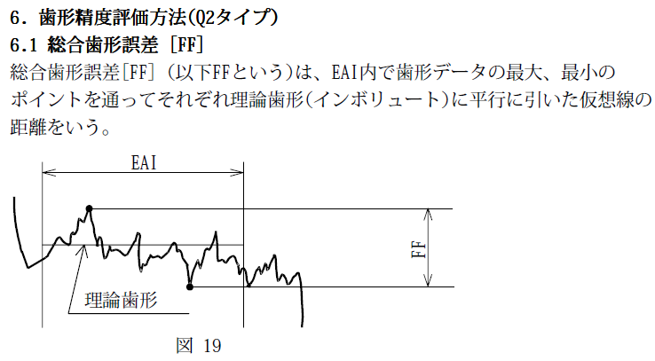
Tooth Profile Training
FF
FF(Ff) : Total Profile Error

Slide 11
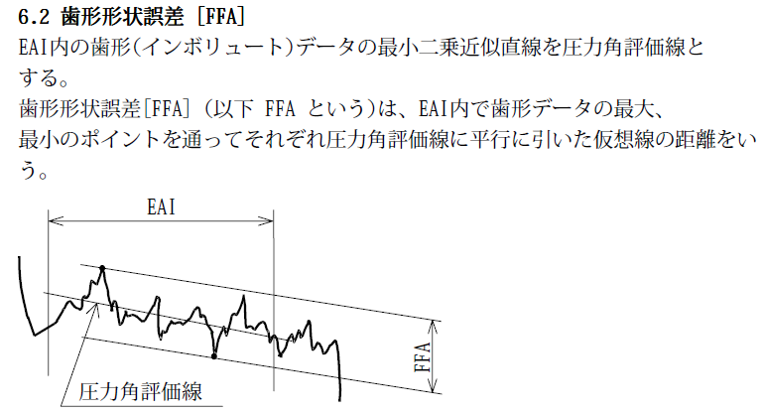
Tooth Profile Training
FFA
FFA(ff) : Profile Form Error

Slide 12
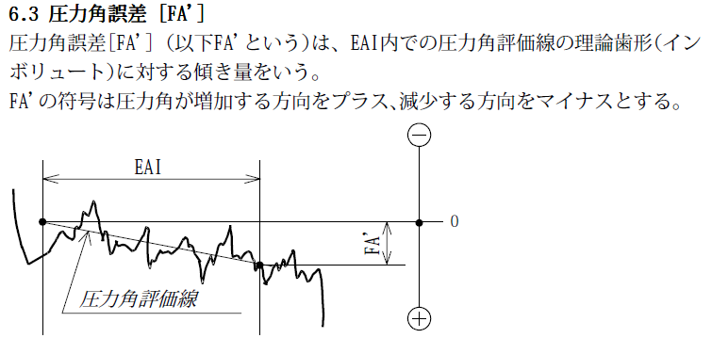
Tooth Profile Training
FA’
FA’(FHα) : Pressure Angle Error

Slide 13
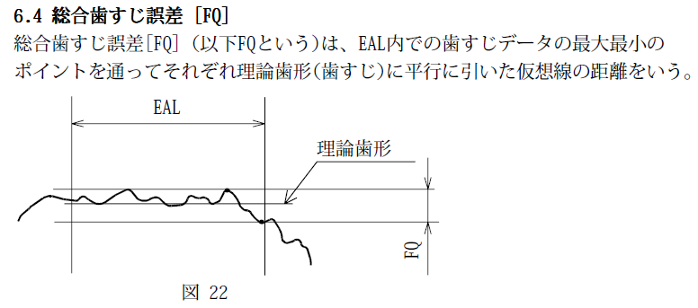
Tooth Profile Training
FQ
FQ(Fβ) : Total Alignment Error

Slide 14
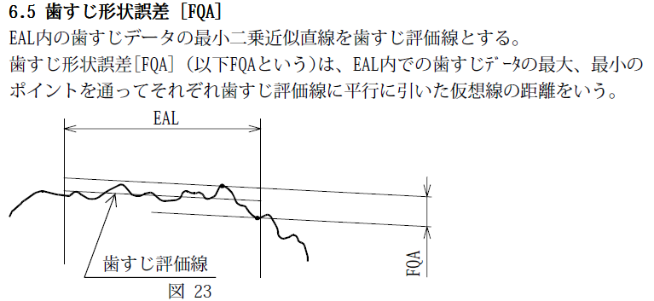
Tooth Profile Training
FQA
FQA(Fβf) : Longitudinal Form Error

Slide 15
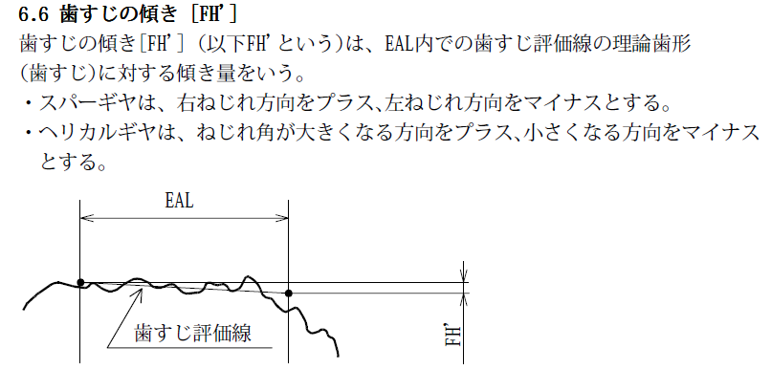
Tooth Profile Training
FQ
FH’(FHβ) : Tooth Alignment Error(Lead Inclination)

Slide 16

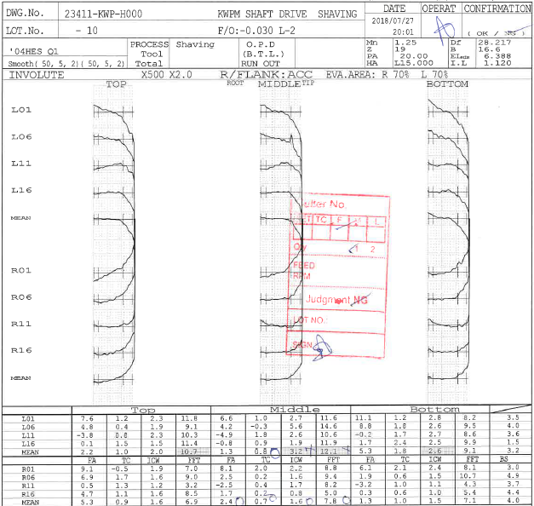






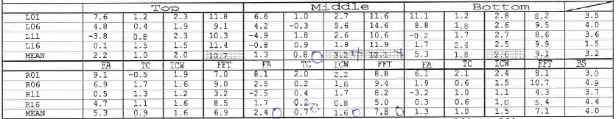
Tooth Profile Training
4TEETH 3POINT
Involute

Slide 17
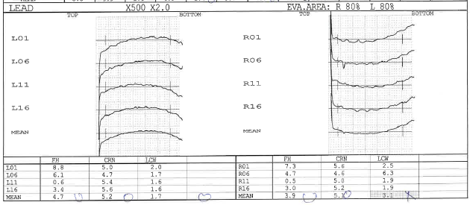


Tooth Profile Training
4TEETH 3POINT
Lead
4TEEH 3POSITION LEAD

Slide 18

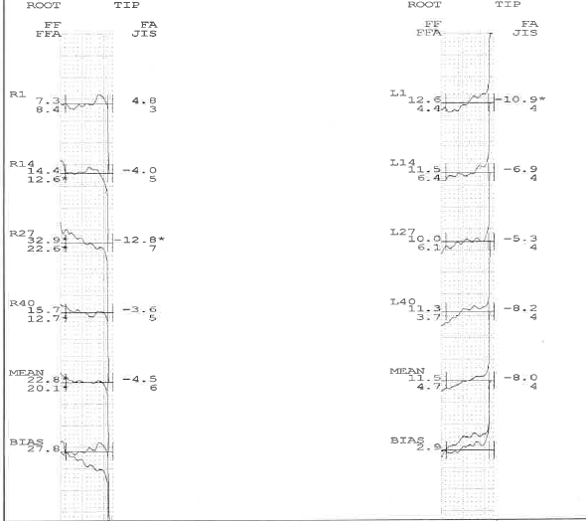

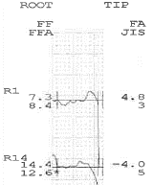






Tooth Profile Training
HOB GRAPH
BIAS= MAX & MIN GAP
INVOLUTE

Slide 19
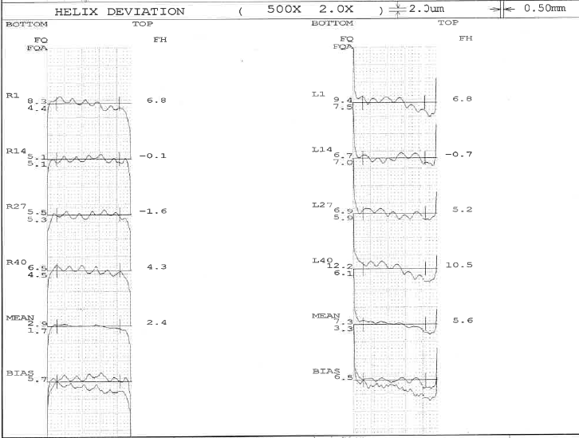


Tooth Profile Training
HOB GRAPH
LEAD

Slide 20
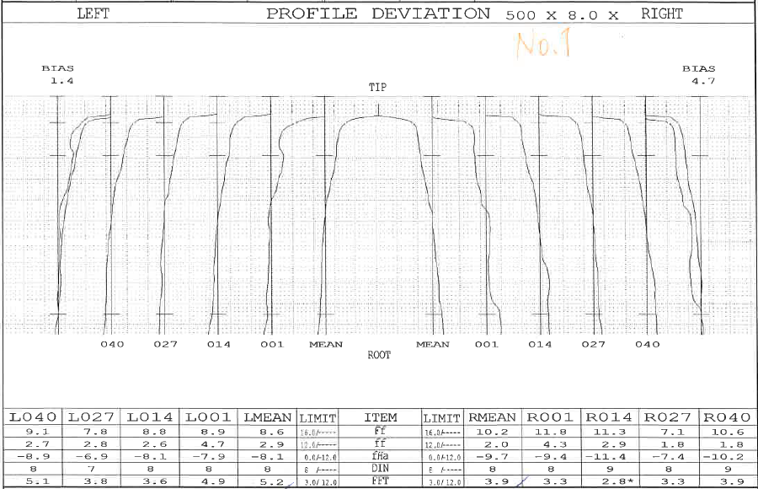


Tooth Profile Training
TVS
INVOLUTE

Slide 21

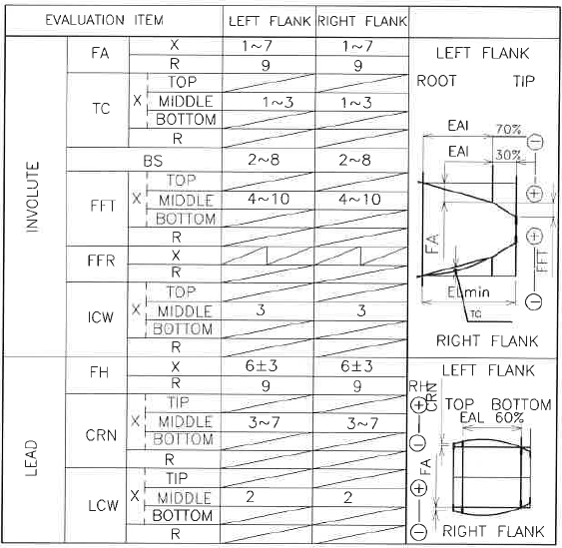
Tooth Profile Training
How to check SPEC
IN PROCESS SHEET MENTION

Slide 22


Thank you very much
Power to Value

